Slide 1
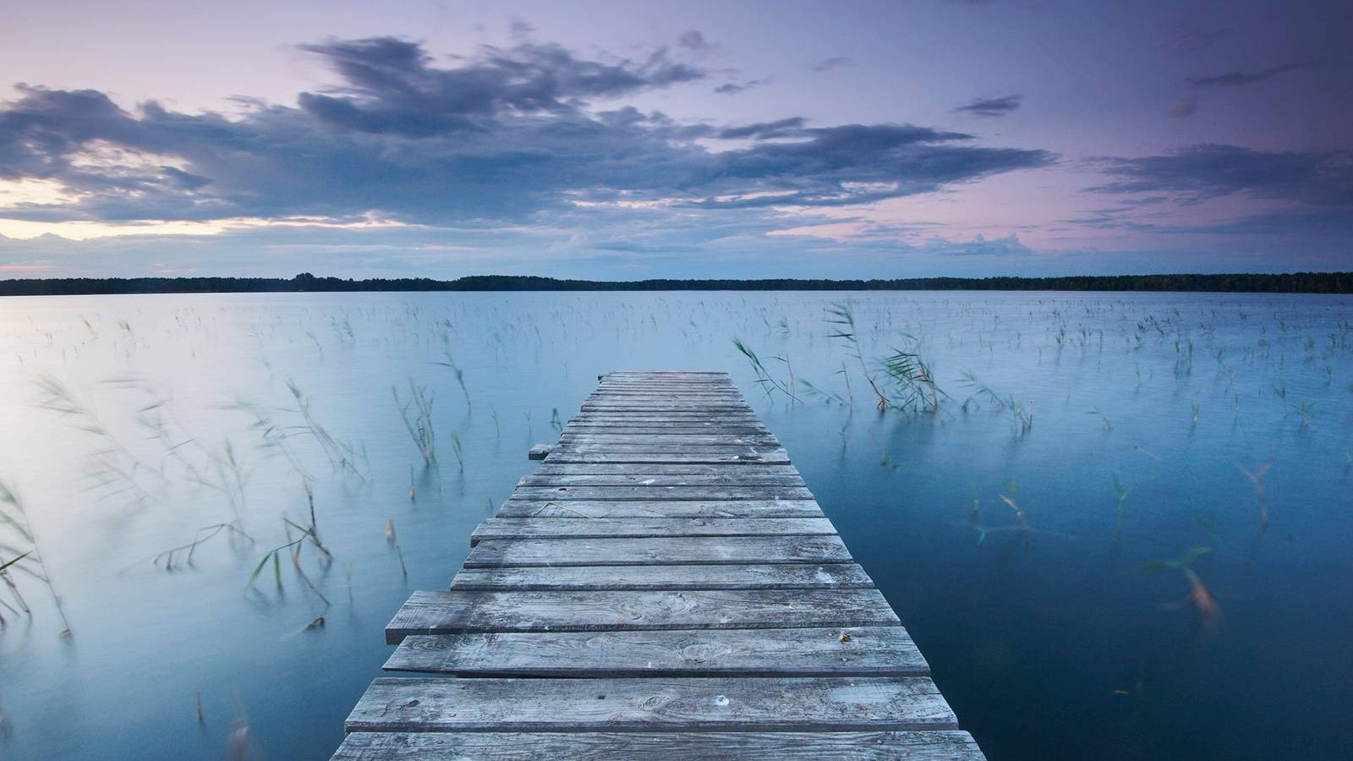
Meditation Recordings

Slide 2
Beginning Meditation
At the top of your screen, on the menu heading, click “Slideshow,” then click “From Beginning” to show this powerpoint in presentation mode.
Then click on the screen to play the recording. Ensure your volume is turned up!

Slide 3
Beach Visualization
Click on the screen to play the audio recording

Slide 4
Forest Visualization
Click on the screen to play the audio recording

Slide 5
Cloud Visualization
Click on the screen to play the audio recording

Slide 6
Peaceful Meadow Visualization
Click on the screen to play the audio recording

Slide 7
Peaceful Waves Visualization
Click on the screen to play the audio recording

Slide 8
Nature Wildlife Sanctuary Visualization
Click on the screen to play the audio recording

